Slide 1

Introduction
Analyse the broad macro-environment of organisations in terms of political, economic, social, technological, environmental (‘green’) and legal factors (PESTEL)
Identify key drivers in this macro-environment and use these key drivers to construct alternative scenarios with regard to environmental change
Use Porter’s five forces analysis and other models to define the attractiveness of industries and sectors and to identify their potential for change
Identify successful strategic groups, valuable market segments and attractive ‘Blue Oceans’ within industries
Use these various concepts and techniques in order to recognise threats and opportunities in the marketplace

Slide 2

Strategic Planning Systems
  Strategic planning systems take the form of systematised, step-by-step, procedures to develop an organisation’s strategy

Slide 3
Strategic Capabilities: The Key Issues
What are strategic capabilities?
How do strategic capabilities contribute to competitive advantage and superior performance?
How to diagnose strategic capabilities?
How to manage the developments of strategic capabilities?

Slide 4
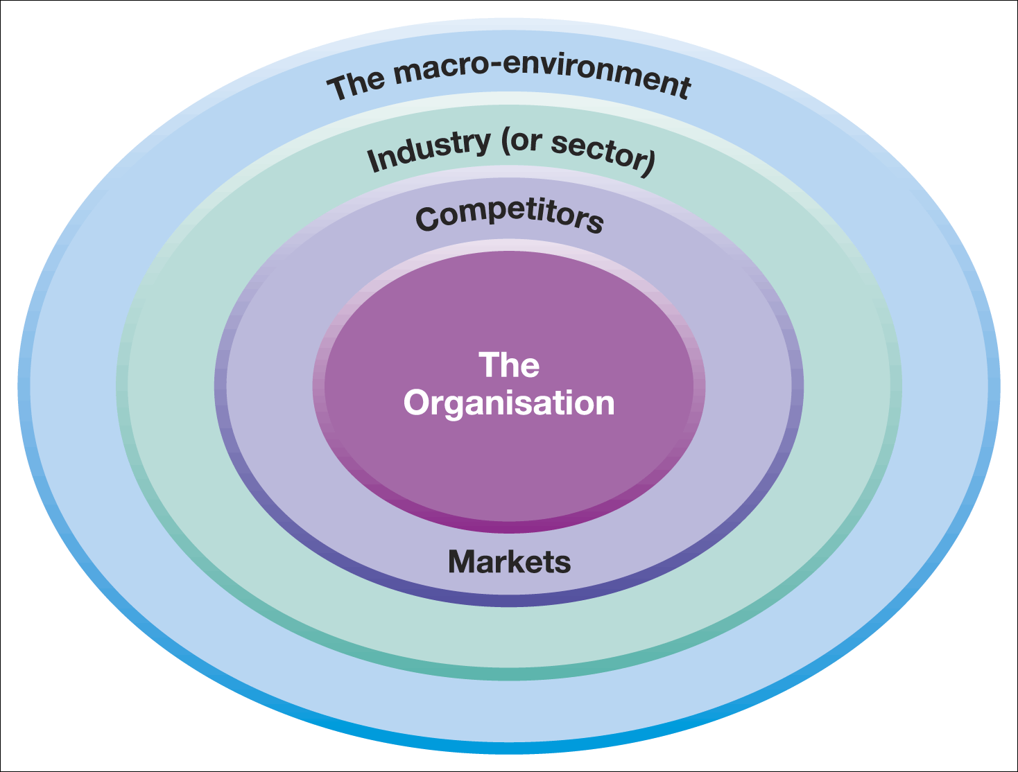
Analysis Tools
Business Environment Layers
PESTLE
Strategic Groups
Five Forces

Slide 5
Large Organisation Stakeholders (Revision)
Firm
Owners Shareholder
Financial Community
Activist Groups
Customers
Managers
Unions
Employees
Trade Associations
Competitors
Suppliers
Government
Political Groups
Adapted from R. E. Freeman, Strategic Management: A Stakeholder Approach , Pitman, 1984. Copyright 1984 by R. Edward Freeman. Johnson, Whittington and Scholes , Exploring Strategy, 9th Edition, © Pearson Education Limited 2011

Slide 6
Components of Strategic Capabilities
Strategic Capability |  | Strategic Capability
Resources (what we have) |  | Competences (what we do well)
Machines, raw materials, products, patents, data bases, computer systems | Physical | Ways of achieving utilisation of plant efficiently, productivity, flexibility marketing
Balance sheets, cash flows, suppliers of funds | Financial | Ability to raise funds and manage cash funds, debtor, creditors etc.
Managers, employees, partners, suppliers, customers | Human | How people use and gain experience, skills, knowledge, build relationships, motivate others and innovate
Long-term Survivability & Competitive Advantage |  | Long-term Survivability and Competitive Advantage
Johnson, Whittington, and Scholes, Exploring Strategy, 9th ed., ©Pearson Education Ltd.

Slide 7
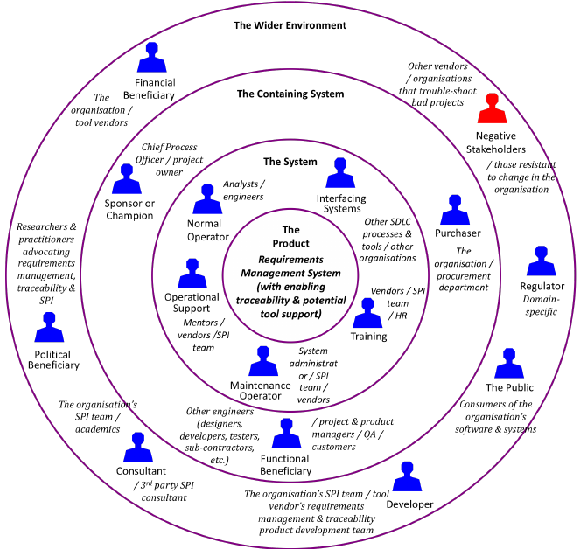
Stakeholder Mapping
Who are the stakeholders?
Stakeholders are those individuals or groups who depend on an organisation to fulfil their own goals and on whom, in turn, the organisation depends
Stakeholder mapping identifies stakeholder expectations and power and helps in understanding political priorities
Source: www.researchgate.net Stakeholder roles for a requirements management system

Slide 8
Stakeholder Conflicts of Expectations
In order to grow, short-term profitability, cash flow and pay levels may need to be sacrificed
Short-termism may suit managerial career aspirations but preclude investment in long-term projects
When family businesses grow, the owners may lose control if they need to appoint professional mangers
New developments may require additional funding through share issue or loans, in either case, financial independence may be sacrificed
Public ownership of shares will require more openness and accountability form the management
Cost efficiency through capital investment can mean job losses
Extending into mass markets may require reduction in quality standards
In public services, a common conflict between mass provision and specialist services(e.g. preventative dentistry or heart transplants)
In large multi-multinational organisations, conflict can result because of a division responsibilities to the company and also to its host country

Slide 9
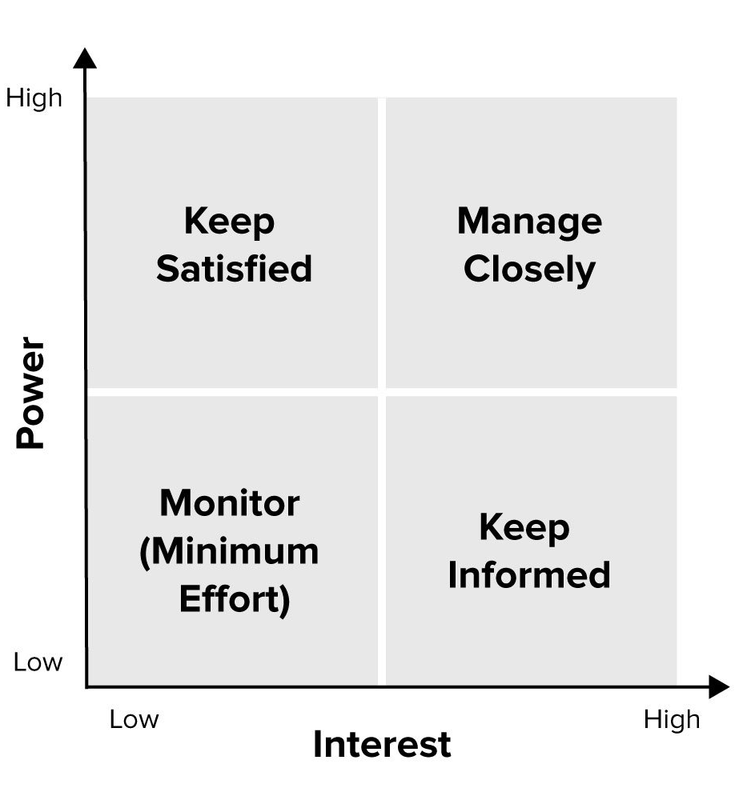
Stakeholder Mapping Questions
Determining purpose and strategy – whose expectations need to be prioritised?
Do the actual levels of interest and power reflect the corporate governance framework?
Who are the key blockers and facilitators of strategy?
Is it desirable to try to reposition certain stakeholders?
Can the level of interest or power of key stakeholders be maintained?
Will stakeholder positions shift according to the issue/strategy being considered?
Source: www.mindtools.com

Slide 10
Customer Ordination & Defining Business
Customer Groups
Who is being satisfied?
Customer Needs
What is being satisfied?
Distinctive Competencies
How are customer needs being satisfied?
Definition of Business
Source: Derek F. Abell, Defining the Business: The Starting Point of Strategic Planning (Englewood Cliffs, N.J.: Prentice-Hall, 1980), p.17

Slide 11

Defining the Business
The focus on satisfying customer needs leads to the principle of providing customer value
Companies should align their strategy to the central values they operate under, such as ethical beliefs, CSR etc.
Marketing can be seen as identifying, creating, communicating and delivering value
By understanding the value customers want companies can position their strategy to meet this need

Slide 12
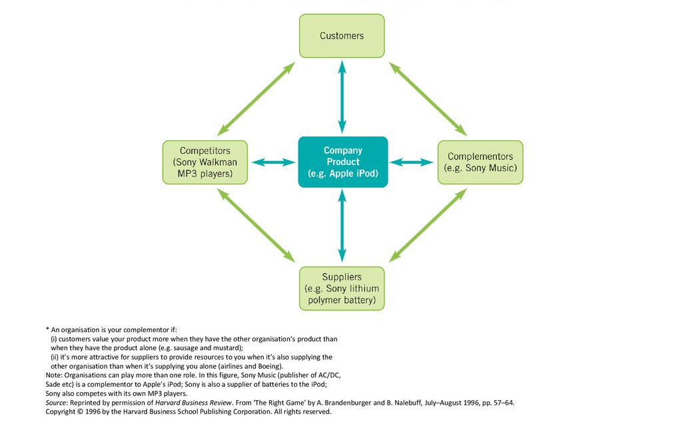
The Value Net
A player is your competitor if your customers value your product less when they have the other player’s product
A player is your complementor if your customers value your product more when they have the other player’s product

Slide 13

Customer Value
The type of value the customer wants satisfied has a direct bearing on the strategy of the firm
There are different types of value that a customer might seek

Slide 14

Customer Value
Functional Value
    The customer is buying the product to perform an actual function, e.g. some customers buy a car purely to get them from A to B and often look for the most economical way to achieve that function
Psychological Value
    The customer is buying a product for the status or esteem that it brings them
Transactional Value
    Applies where the product or services available are virtually identical so the distinguishing feature will be the ease with which the customer can buy the product or service

Slide 15
Defining the Business
(Process)
Analysis
Five Forces
Identifies the reasons for the competitive pressures within the industry
Strategic group analysis
Identifies the characteristics of groups within the industry
Value chain analysis
Assesses the capabilities of the company
Choice
Generic Strategies
Low cost
Differentiation
Focus
Implementation
Configure value chain
Value chain and value systems are configured are best suit the chosen strategy

Slide 16
Industries, Markets, & Sectors
An industry is a group of firms producing products and services that are essentially the same. For example, pharmaceutical industry and airline industry
A market is a group of customers for specific products or services that are essentially the same (e.g. the market for luxury cars in Germany)
A sector is a broad industry group (or a group of markets) especially in the public sector (e.g. the health sector)

Slide 17
Three Major Business Strategies (Porter, 1985)
Cost Leadership
Increasing profits by reducing costs, while charging industry-average prices
Increasing market share by charging lower prices, while still making a reasonable profit on each sale because of reduced costs
Differentiation
Involves making products or services different from & more attractive than those of the competitors
Focus
Concentrate on niche markets
By understanding the dynamics of that market and the unique needs of customers within it
Develop uniquely low-cost or well-specified products for the market
Notes:
Differentiation involves making your products or services different from and more attractive than those of your competitors. How you do this depends on the exact nature of your industry and of the products and services themselves, but will typically involve features, functionality, durability, support, and also brand image that your customers value.
Focus Strategy
Companies that use Focus strategies concentrate on particular niche markets and, by understanding the dynamics of that market and the unique needs of customers within it, develop uniquely low-cost or well-specified products for the market. Because they serve customers in their market uniquely well, they tend to build strong brand loyalty amongst their customers. This makes their particular market segment less attractive to competitors.
As with broad market strategies, it is still essential to decide whether you will pursue Cost Leadership or Differentiation once you have selected a Focus strategy as your main approach: Focus is not normally enough on its own.
But whether you use Cost Focus or Differentiation Focus, the key to making a success of a generic Focus strategy is to ensure that you are adding something extra as a result of serving only that market niche. It's simply not enough to focus on only one market segment because your organization is too small to serve a broader market (if you do, you risk competing against better-resourced broad market companies' offerings).

Slide 18
Cost Leadership Strategy
Business Strategy | Common Organisational Characteristics | HR Strategies
Cost leadership strategy is aimed at gaining a competitive advantage through lower costs. Requires aggressive construction of efficient plant facilities, intense supervision of labor, vigorous pursuit of cost reductions, and tight control of distribution costs and overheads. | Sustained capital investment & access to capital Intense supervision of labour Tight cost control requiring frequent, detailed control reports Low-cost distribution system Structured organisation and responsibilities Products designed for ease in manufacture | Efficient production Explicit job descriptions Detailed work planning Emphasis on technical qualifications and skills Emphasis on job-specific training Emphasis on job-based pay Use of performance appraisal as a control device

Slide 19
Differentiation Strategy
Business Strategy | Common Organisational Characteristics | HR Strategies
Differentiation business strategy attempts to achieve a competitive advantage by creating a product or service that is perceived as unique Approaches to differentiation can take may forms, among them: design or brand image; technology; features; customer service; and dealer networks | Strong marketing abilities Product engineering Strong capability in basic research Corporate reputation for quality or technological leadership Amenities to attract highly skilled labour, scientists, or creative people | Emphasis on innovation and flexibility Broad job classes Loose work planning External recruitment Team-based training Emphasis on individual-based pay Use of performance appraisal as development tool

Slide 20
Focus Business Strategy
Attempts to achieve a competitive advantage by creating a product or service that is perceived as unique and, by understanding the dynamics of that market and the unique needs of customers within it, develop uniquely low-cost or well-specified products for the market
Tend to build strong brand loyalty amongst their customers. This makes their market segment less attractive to competitors
As with broad market strategies, it is still essential to decide whether to pursue Cost Leadership or Differentiation once a focus strategy has been selected as the main approach
Focus is not normally enough on its own
Whether Cost Focus or Differentiation Focus, key is to ensure that the business is adding something extra as a result of serving only that market niche
Not enough to focus on only one market segment because the organization is too small to serve a broader market
(Risk competing against better-resourced broad market companies' offerings)

Slide 21
Competitive Advantage Models (HRM)
Cost Reduction
HR strategy is likely to focus on the delivery of efficiency through mainly ‘hard’ HR techniques
Quality Enhancement
Encourages employee involvement and employee flexibility
Innovation
HR strategies focus on the delivery of added value through ‘softer’ HR techniques and policies
Three key bases
Cost Leadership
Differentiation through quality and service
Focus or ‘niche’ market - to ‘fit’ the generic strategies of cost reduction, quality enhancement and innovation

Slide 22
Miles & Snow Model
Prospector
Learning orientation; flexible, fluid, decentralized structure
Values creativity, risk-taking, and innovation
Defender
Efficiency orientation; centralized authority and tight cost control
Emphasis on production efficiency, low overhead
Analyzer
Balances efficiency and learning; tight cost control with flexibility and adaptability
Emphasis on creativity, research, risk-taking for innovation
Reactor
No clear organizational approach; design characteristics may shift abruptly depending on current needs

Slide 23
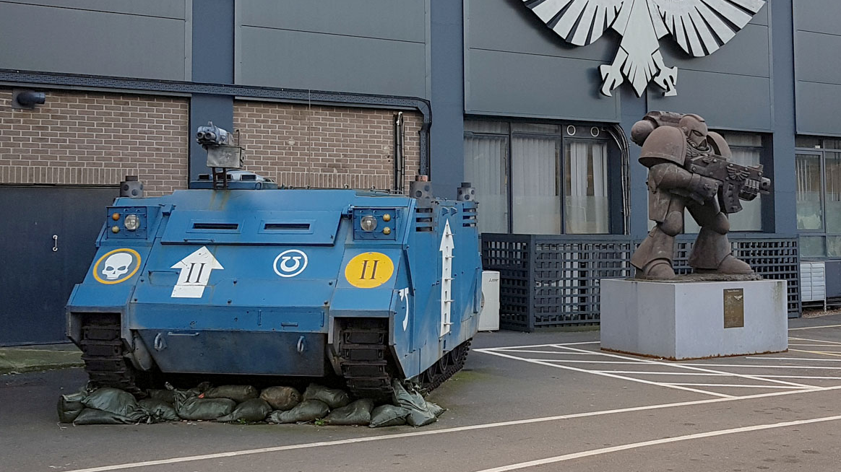
VRIN (1) V – Value of Strategic Capabilities
Strategic capabilities are of value when they:
  Take advantage of opportunities and neutralise threats
  Provide value to customers
  Provide potential competitive advantage
  At a cost that allows an organisation to realise acceptable levels of return
  Games Workshop: a case study in sound management
  https://www.investorschronicle.co.uk/comment/2020/01/08/games-workshop-a-case-study-in-sound-management-and-operational-gearing/

Slide 24

RIN (2) R – Rarity
  Rare capabilities are those possessed uniquely by one organisation or by a few others only. (E.g. a company may have patented products, have supremely talented people or a powerful brand. )
  Rarity could be temporary. (Eg: Patents expire, key individuals can leave or brands can be de-valued by adverse publicity.)
  Thomas Alva Edison (1878) The lightbulb
The Lightbulb Staircase of Grand Cafe Orient in the House of the Black Madonna, Prague. Designed by Josef Gočár in 1911

Slide 25
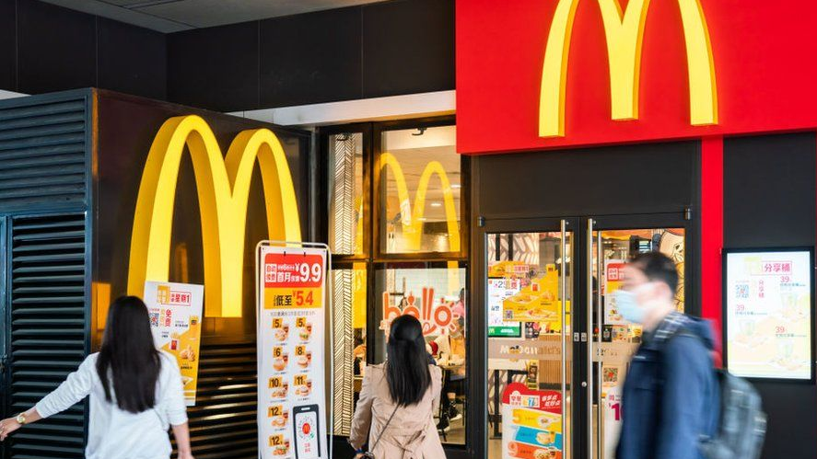
VRIN (3) I Inimitability
  Inimitable capabilities are those that competitors find difficult to imitate or obtain
  Competitive advantage can be built on unique resources (a key individual or IT system) but these may not be sustainable (key people leave or others acquire the same systems)
  Sustainable advantage is more often found in competences (the way resources are managed, developed and deployed) and the way competences are linked together and integrated

Slide 26
Criteria for the Inimitability of Strategic Capabilities
Inimitability of Strategic Capabilities
Complexity
Internal linkages
External linkages
Casual Ambiguity
Characteristic ambiguity
Linkage ambiguity
Culture and History
Taken-for-granted activities
Path dependency
Change
To Innovate
And keep ahead of the competitors

Slide 27

VRIN (4) N - Non-substitutability
  Competitive advantage may not be sustainable if there is a threat of substitution
  Product or service substitution from a different industry/market. For example, postal services partly substituted by e-mail
  Competence substitution. For example, a skill substituted by expert systems or IT solutions

Slide 28
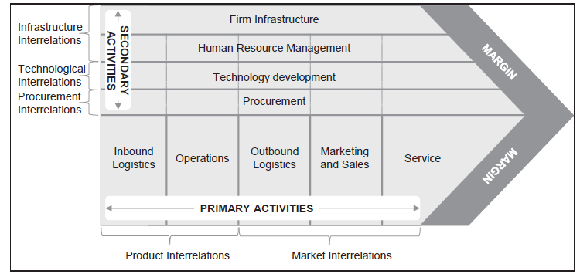
VRIN Summary (Porter)

Slide 29

Organisational Knowledge
  Organisational knowledge is the collective intelligence, specific to an organisation, accumulated through both formal systems and the shared experience of people in that organisation
  Some of this knowledge is ‘Tacit’ knowledge that is, more personal, context-specific and hard to formalise and communicate – so it is difficult to imitate, for example, the knowledge and relationships in a top R&D team

Slide 30
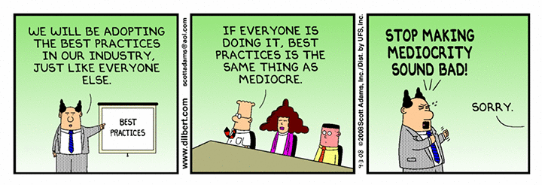
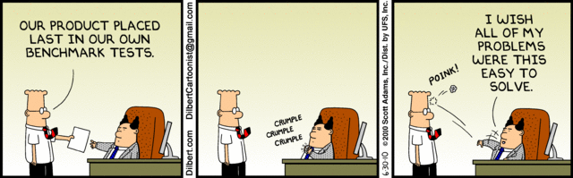
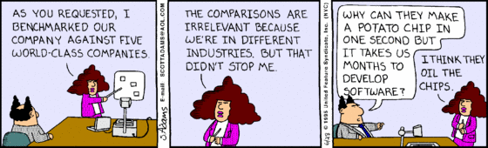
Benchmarking
  Benchmarking is a means of understanding how an organisation compares with others – typically competitors
  Two approaches to benchmarking:
    Industry/sector benchmarking - comparing performance against other organisations in the same industry/sector against a set of performance indicators
    Best-in-class benchmarking - comparing an organisation’s performance or capabilities against ‘best-in-class’ performance – wherever that is found even in a very different industry. (E.g. BA benchmarked its refuelling operations against Formula 1)

Slide 31

The Value Chain
The value chain describes the categories of activities within an organisation which, together, create a product or service
The value chain invites the strategist to think of an organisation in terms of sets of activities – sources of competitive advantage can be analysed in any or all of these activities

Slide 32
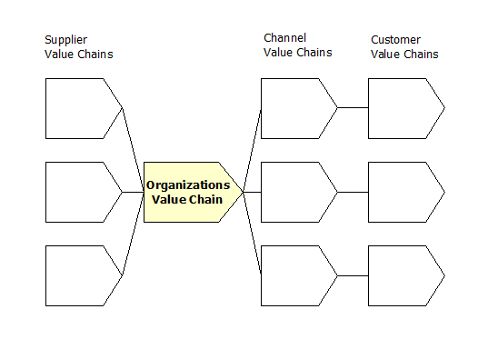
The Value Network
The value network comprises the set of interorganisational links and relationships that are necessary to create a product or service
Competitive advantage can be derived from linkages within the value network

Slide 33
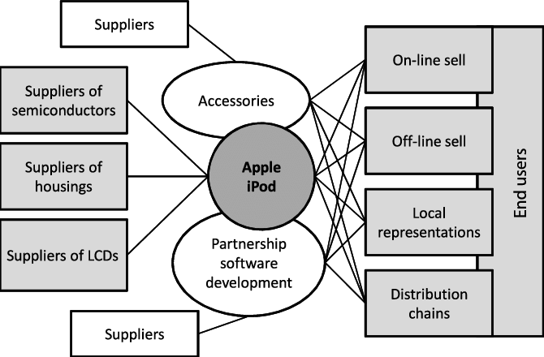
The Value Network (Apple iPod)

Slide 34

Uses of the
Value Chain
A generic description of activities – understanding the discrete activities and how they both contribute to consumer benefit and how they add to cost
Identifying activities where the organisation has particular strengths or weaknesses
Analysing the competitive position of the organisation using the VRIN criteria – thus identifying sources of sustainable advantage
Looking for ways to enhance value or decrease cost in value activities (e.g. outsourcing)

Slide 35
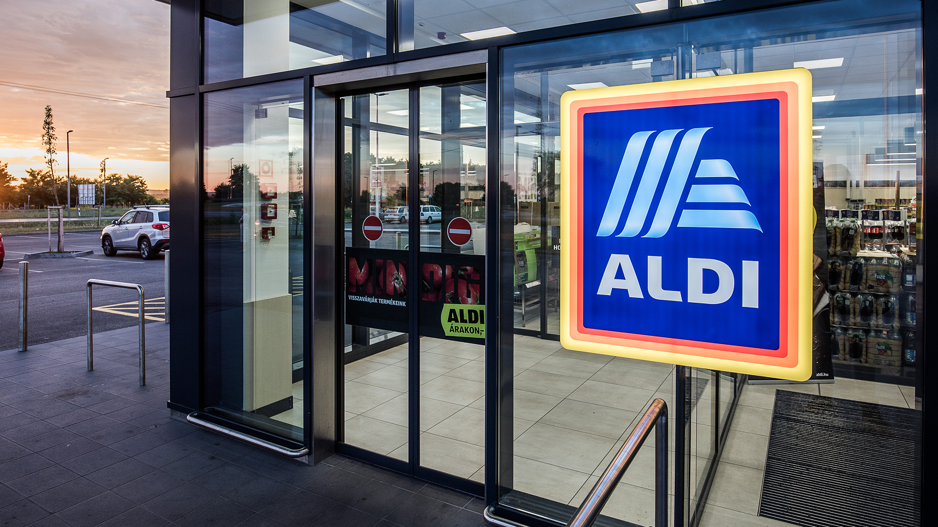
Uses of the
Value Network
Understanding cost/price structures across the value network – analysing the best area of focus and the best business model
Identifying ‘profit pools’ within the value network and seek to exploit these
The ‘make or buy’ decision: deciding which activities to do ‘in-house’ and which to outsource
Partnering and relationships – deciding who to work with and the nature of these relationships
Aldi discount supermarket changed Britain’s shopping https://www.theguardian.com/business/2019/mar/05/long-read-aldi-discount-supermarket-changed-britain-shopping

Slide 36
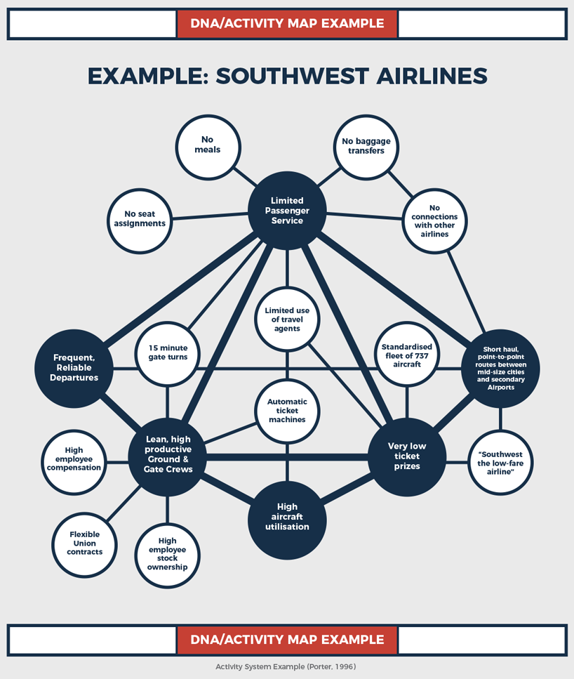
Mapping Activity Systems
Identify ‘higher order strategic themes’ that is, how the organisation meets the critical success factors in the market
Identify the clusters of activities that underpin these themes and how they fit together
Map this in terms of how activity systems are interrelated

Slide 37
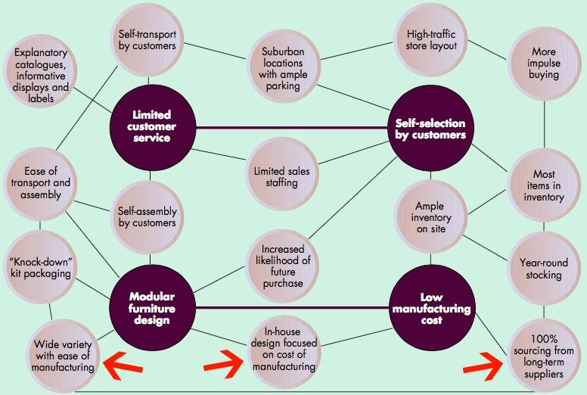
Mapping Activity Systems
Ikea Production & Procurement
https://www.cmc-consultants.com/blog/a-look-into-the-ikea-procurement-policy-and-production-model-in-china

Slide 38
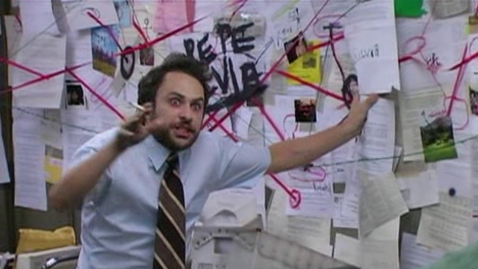
Using
Activity System Maps
A means of identifying strategic capabilities in terms of linkages of activities
Internal and external links are identified (e. g. in terms of the needs of customers)
Therefore helps identify bases of competitive advantage
And sustainable advantage for example, in terms of bases of inimitability

Slide 39

Developing
Strategic Capabilities (1)
Internal capability development:
  Leveraging capabilities
    Identifying capabilities in one part of the organisation and transferring them to other parts (sharing best practice)
  Stretching capabilities
    Building new products or services out of existing capabilities

Slide 40

Developing
Strategic Capabilities (2)
External capability development
  Adding capabilities through mergers, acquisitions or alliances
Ceasing activities
  Non-core activities can be stopped, outsourced or reduced in cost
Monitor outputs and benefits
  To understand sources of consumer benefit and enhance anything that contributes to this
Managing the capabilities of people
  Training, development and organisation learning

Slide 41
Market Structures
Number of firms within a markets (lesser extent the number of purchasers)
Perfect Competition
Monopolistic Competition
Monopoly
Oligopoly
Monopsony
Bilateral Monopoly

Slide 42
Perfect Competition
No one producer has an advantage over another
Supply & Demand
Demand measures the amount of a good or service which buyers are willing to spend
(Note not the amount that they need)
Lower the price the greater the quantity which buyers will demand
Demand Curve
Increase in Demand
Supply Curve
Supply, Demand & Equilibrium
House Prices?

Slide 43
Perfect Competition
Assumption that product are assumed to be identical
Market players are all well informed
No point in advertising
Entry to the market is completely free
Incentive to cut process i.e. can sell as much as one likes
Extremely Unlikely
Why
Attempts to explain behaviour (Idealist)
Efficient use of resources
Production methods costs reduced
Profits long-term not short-term
No incentive to innovate
Labour markets?

Slide 44

Monopolistic Competition
Many firms compete in a market but each will sell a slightly different product
  Slightly more freedom in setting their prices
  Charge a slightly higher price
  Sell slightly lower volume of goods
  To an extent price makers - customer loyalty
  Products difference is not necessarily but what the customer perceive it is
  Heavy advertisement
  Hotels, coffee shops, toilet paper

Slide 45
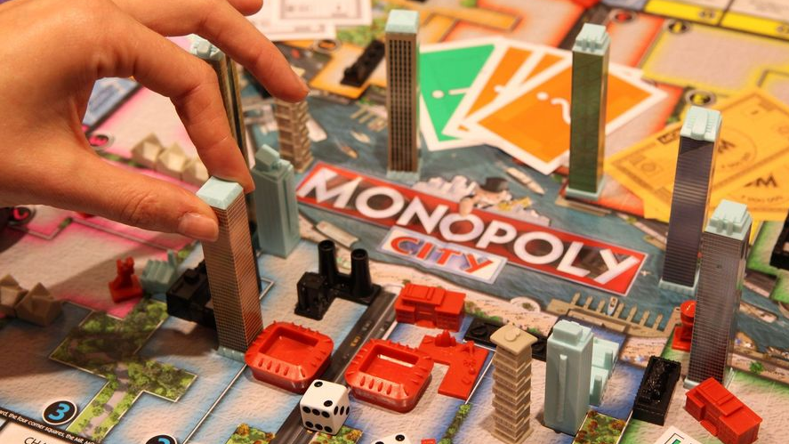
Monopoly
100% of the market - very rare
Able to control the market price of the product that it produces
Does not need to control all of the market – 50%
Can manipulate the price and quantity to increase profit
Can lead to excess profit but what if no one wants to buy?
Encourages inefficiently in management and production
Misallocation of resources in the economy as a whole
Not always in best interest of customers – US anti-trust legalisation
Facebook's 'monopoly' must be split up, US and states say in major lawsuits –Facebook's 'monopoly' must be split up, US and states say in major lawsuits (Guardian 9th December 2020)
Advantage
  Economies of scale
  May be a necessary part of the competitive process – temporary rise and fall – ‘Creative Destruction’ (Schumpeter 1976)
  Monopoly profits based on restriction to the market, drive towards innovation - patents

Slide 46
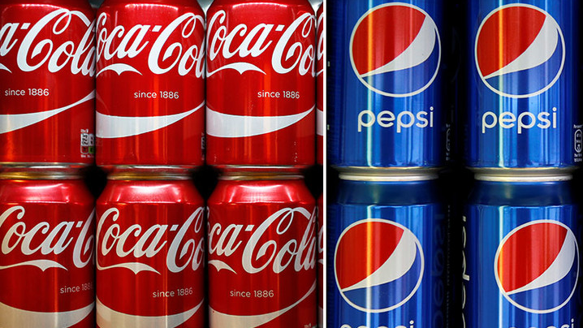
Oligopoly
  Exist when a few large producers control the market
  Number of firms can vary and products can be homogeneous or diversified
  Firms are interdependent – one firms actions must be followed by the others in the market
  Globalisation impact on domestic markets
  Five Firm Concentration
  Common
    Sugar
    Gas Distribution
    Oil & Fats
    Tobacco
    Confectionery
  Least Common
    Metal Forging,
    Plastic
    Furniture Construction
    Structural Metal (UK 2004)

Slide 47

Monopsony & Bilateral Monopoly
  Monopsony
    Market where there is monopoly buyer
    Normally Government or one of its agencies
    Health & Pharmaceutical companies
    Silicon Valley a example of monopsony power in the labour market
  Bilateral Monopoly
    Market where a monopoly is selling to a monopsony
    Patented drugs from one pharmaceutical company

Slide 48
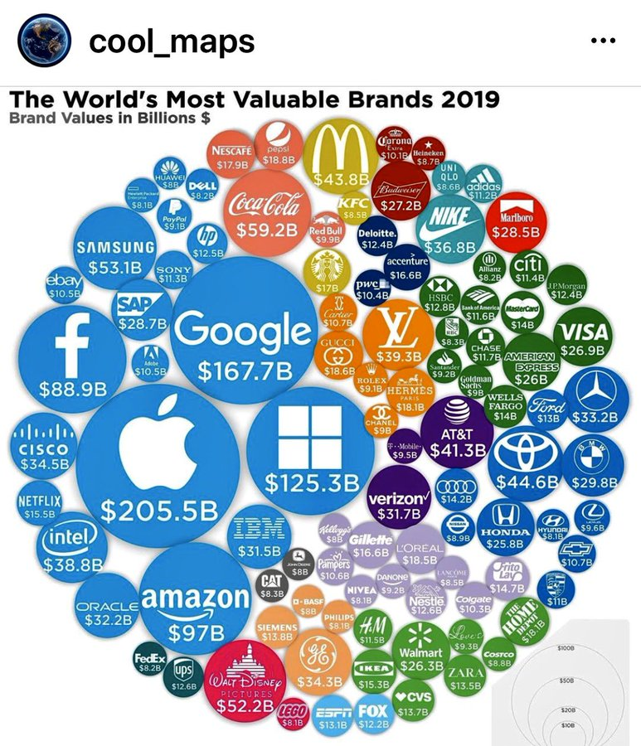
Oligopoly
Price War
Aim driving out competition & emerge with a single firm (Monopoly)
Risky - may lose
Create vacuum whereby a more powerful rival emerges
Non-Price Competition
Compete on everything bar price – BOGOF
Aim to gain marginal increase in market share
Understanding the rules, limited war – result for customer almost impossible to compare prices – gas and electricity offers
Price Leadership
Unofficial market leader – if changes process the rest are likely to follow – legal if no collusion
Game Theory
Assumption of the nature of the environment & behaviour of the competitors
Maximax best combination & Maximin worst will happen

Slide 49

Monopoly & Antitrust Lawsuits
  Apple App Store Policies
  2020 Apple removes Epic Games’ battle royale game Fortnite from the App Store after the developer implemented its own in-app payment system. Bypassed Apple’s standard 30% fee
  Response
    Antitrust lawsuit seeking to establish Apple’s App Store as a monopoly
    Protest video that aired on YouTube and within Fortnite itself
  Two ongoing antitrust investigations into Apple conducted by the European Union, launched after Spotify and other app makers protested App Store policies
  Further criticism how it applies its guidelines – unfair and may in fact be designed to benefit Apple over its competitors (Amazon)
  Issue similar with Google - game removed from Play Store
https://edition.cnn.com/2020/08/13/tech/fortnite-apple-store-removed/index.html

Slide 50
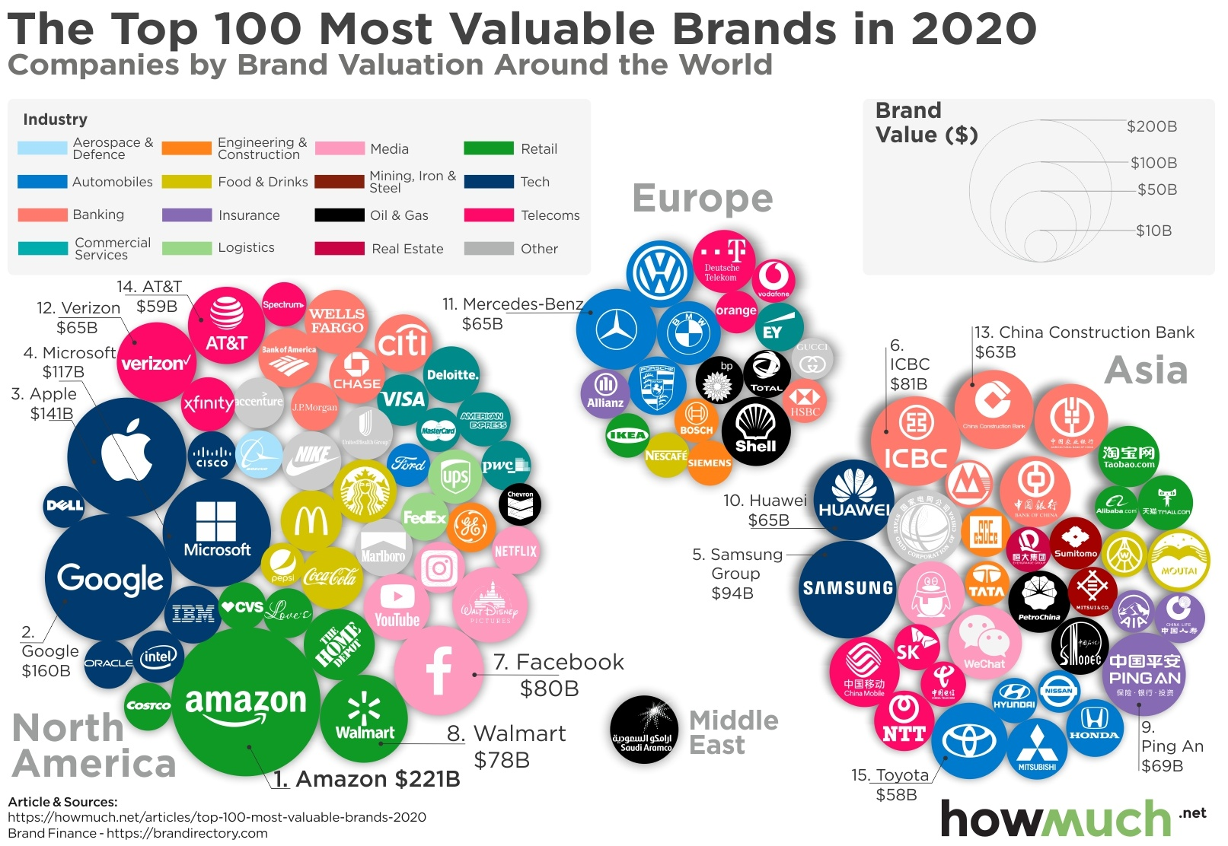

Slide 51
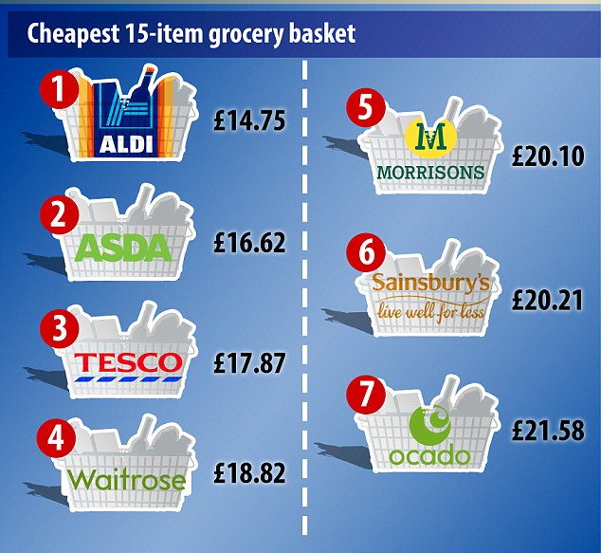
Strategic Responses
If not in an Monopoly or Oligopoly & not in a position to mange its environment / competition organisations have two choices;
Opt for low price or
Opt for differentiations
Aldi / Lidl –v- Marks and Spencer
Ryanair –v- Etihad
https://www.dailymail.co.uk/news/article-2902084/Budget-supermarkets-strike-blow-against-big-boys-15-item-shopping-basket-Aldi-proves-1-87-cheaper-closest-rival-Asda.html

Slide 52
Pricing Strategy Nagle & Holden (2002)
Reference Price Effect
Difficult Comparison Effect
Switching Cost Effect
Price Quality Effect
Expenditure Effect
End-benefit Effect
Shared Cost Effect
Fairness Effect
Framing Effect

Slide 53
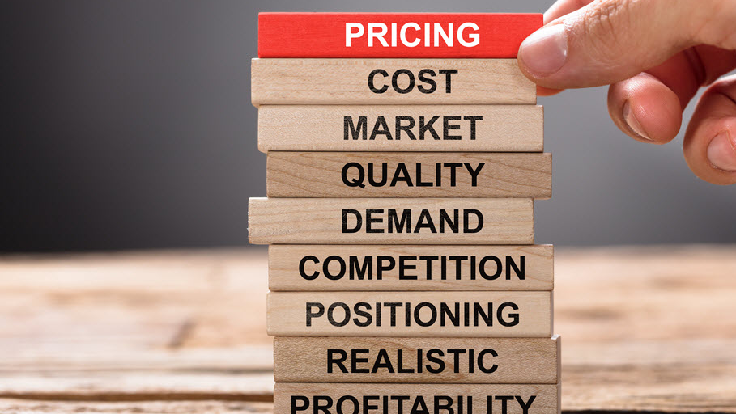
Alternative Pricing Strategies
  Premium - Unique brand
  Economy - No frills
  Promotional BOGOF’s
  Optional Product - Extras (Ryanair)
  Captive Product - Complements (Razors)
  Penetration - artificially low process to enter a new market, then increased
  Skimming - High price for product before competition moves in
  Price Discrimination - can’t be resold
    Airline tickets
    Tanzania National Park ($1 –v- $50)

Slide 54
Cycles of Competition
Incumbent
Entrant
Builds or inherits entry barriers
No response
Reinforces barriers
Attacks entrant’s home market
Attacks ‘soft’ Market segment
Widens attack to adjacent segments
Starts price war
Restarts the cycle in adjacent market
Adapted with the permission of The Free Press, a Division of Simon & Schuster, Inc., from Hypercompetitive Rivalries: Competing in Highly Dynamic Environments by Richard A. D ’Aveni with Robert Gunther. Copyright © 1994, 1995 by Richard A. D’Aveni. All rights reserved

Slide 55
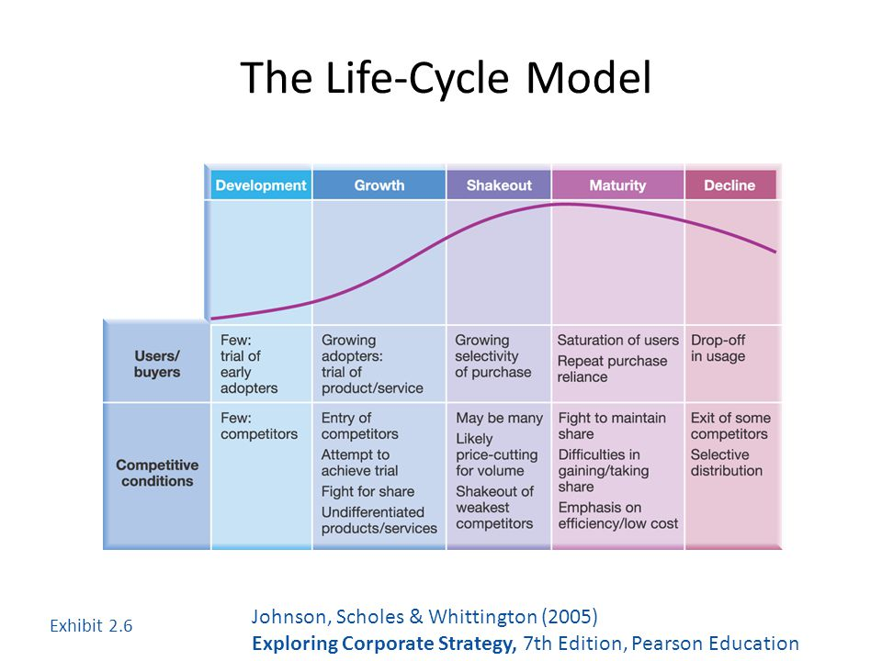
The Life-Cycle Model
Johnson, Scholes & Whittington (2005)

Slide 56
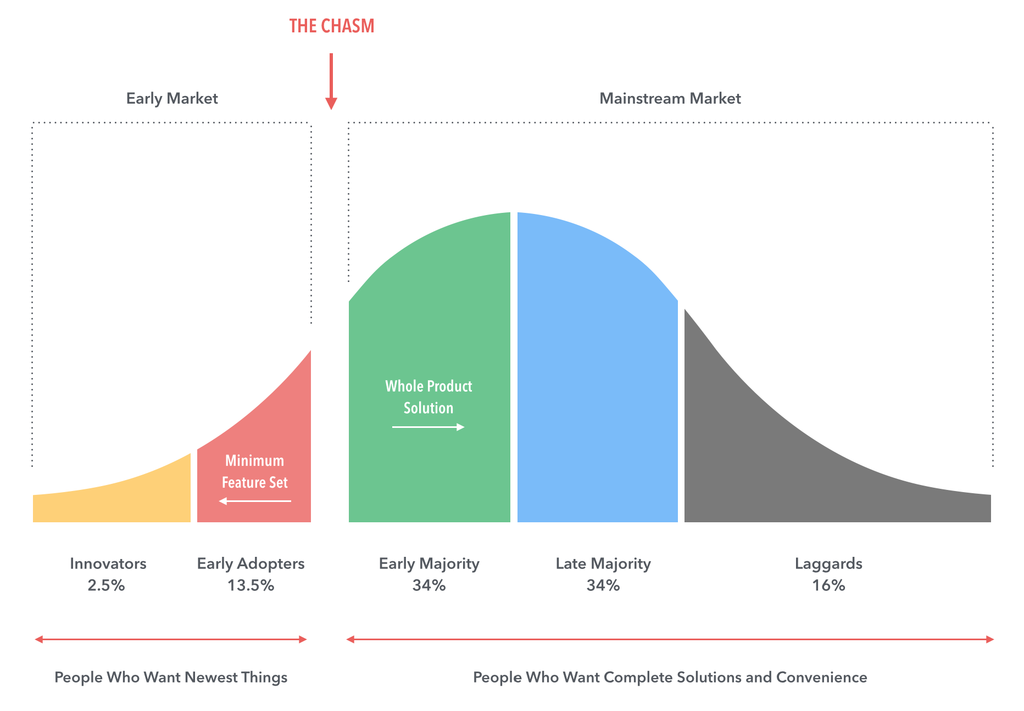
Crossing the Chasm

Slide 57

Crossing the Chasm in Consumer Markets (Geoffrey Moore) https://www.youtube.com/watch?v=izP5n1SBEaI

Slide 58
Life-Cycle Models
Start-up Phases
Growth Stage
Maturity Stage
Decline Stage
How can strategy secure and retain the type of operations that are necessary for the organisation’s continued viability, as industries and sectors develop?
Which strategies and practices are more likely to contribute to sustainable competitive advantage as organisations go through their life-cycle
Flexibility
Grow size of organisation
Development of more formal policies and procedures
Move to cost control by strategy

Slide 59
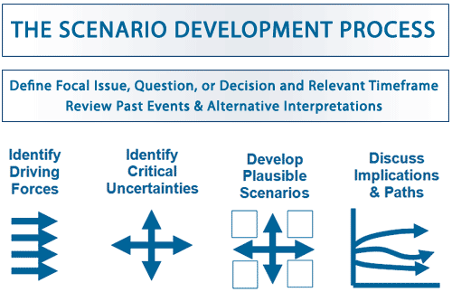
Scenario
Scenarios are detailed and plausible views of how the environment of an organisation might develop in the future based on key drivers of change about which there is a high level of uncertainty
Build on PESTEL Analysis
Do not offer a single forecast of how the environment will change
An organisation should develop a number of alternative scenarios to analyse future strategic options

Slide 60

The Art of the Long View
Peter Schwartz (2003)
Evolution
  All trends continue as expected. Things gently move toward a predictable end point.
Revolution
  A new, disruptive, factor fundamentally changes the situation.
Cycles
  What goes around comes around. Boom follows bust follows boom follows bust
Infinite Expansion
  Exciting trends continue. Think of the computer industry in the 1950
Lone Ranger
  The triumph of the lone hero against the forces of inertia
My Generation
  Changes in culture and demographics affect the situation

Slide 61

Conducting Scenario Analysis
  Identify the most relevant scope of the study – the relevant product/market and time span
  Identify key drivers of change – PESTEL factors that have the most impact in the future but have uncertain outcomes
  For each key driver select opposing outcomes where each leads to very different consequences
  Develop scenario ‘stories’ – coherent and plausible descriptions of the environment that result from opposing outcomes
  Identify the impact of each scenario on the organisation and evaluate future strategies in the light of anticipated scenarios
  Scenario analysis is used in industries with long planning horizons, e.g. oil industry, airlines

Slide 62
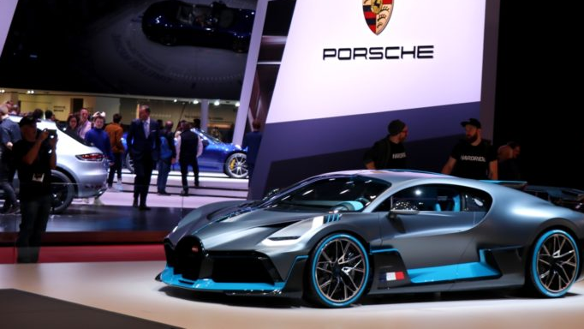
Strategic Groups
Strategic groups are organisations within an industry or sector with similar strategic characteristics, following similar strategies or competing on similar bases
These characteristics are different from those in other strategic groups in the same industry or sector
There are many different characteristics that distinguish between strategic groups
Strategic groups can be mapped on to two dimensional charts – maps
These can be useful tools of analysis

Slide 63
Competitor Analysis Strategic Group Concept
The scope of an organisation’s activities (product range, geographical coverage & resource commitment (brands, marketing spend etc.)
Understanding competition
Analysis of strategic opportunities
Analysis of mobility barriers (Johnson et al 2011)
Portfolio Analysis
Strategic emphasis on organisations building up a balance portfolio of activities, or Strategic Business Units (SBU)

Slide 64
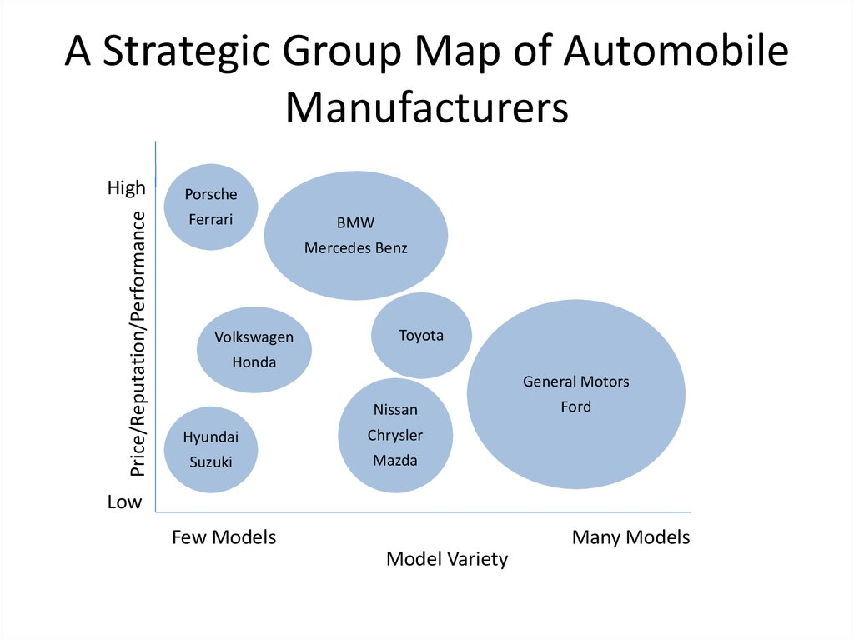
A Strategic Group Map of
Automobile Manufacturers

Slide 65
Characteristics for Identifying Strategic Groups
Scope of Activities
Extent of product for service diversity cope of activities
Extent of geographical coverage
Number of market segments served
Distribution channels used
Resource Commitment
Extent (number) of branding
Marketing effort (e.g. advertising spread, size of sales force)
Extent of vertical integration
Product or service quality
Technological leadership (a leader or follower)
Size of organisations

Slide 66

Uses of Strategic Group Analysis
Understanding competition - enables focus on direct competitors within a strategic group, rather than the whole industry. (E.g. Tesco will focus on Aldi, Dunnes etc.)
Analysis of strategic opportunities - helps identify attractive ‘strategic spaces’ within an industry
Analysis of ‘mobility barriers’ i.e. obstacles to movement from one strategic group to another
These barriers can be overcome to enter more attractive groups
Barriers can be built to defend an attractive position in a strategic group

Slide 67
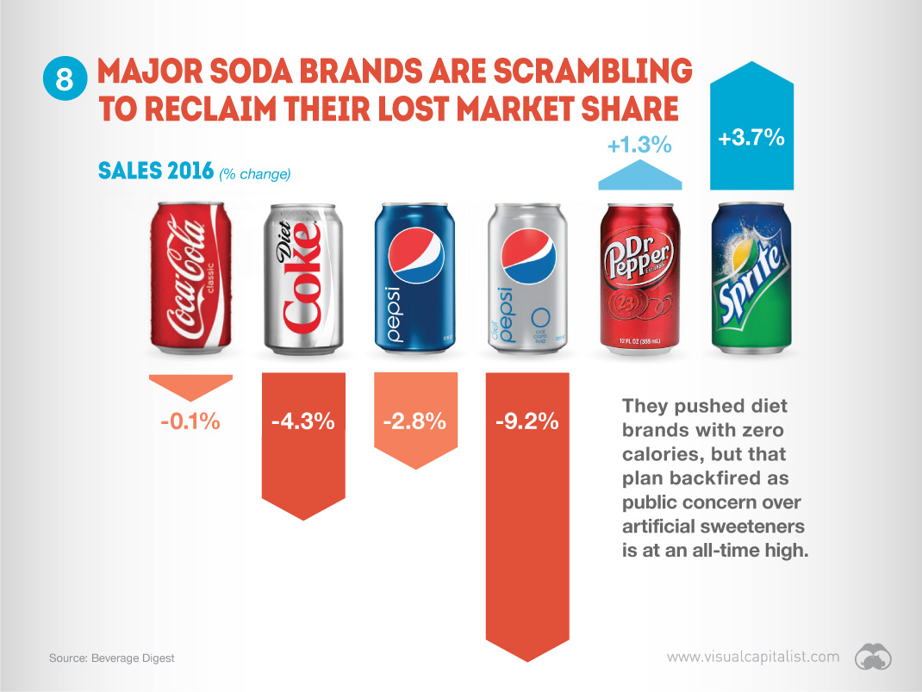

Slide 68

Market Segments
A market segment is a group of customers who have similar needs that are different from customer needs in other parts of the market
Where these customer groups are relatively small, such market segments are called ‘niches’
Customer needs vary
Focusing on customer needs that are highly distinctive is one means of building a secure segment strategy
Customer needs vary for a variety of reasons - these factors can be used to identify distinct market segments
Not all segments are attractive or viable market opportunities – evaluation is essential

Slide 69
Bases of Market Segmentation
Factor Types | Consumer Markets | Industrial/Organisational Markets
Characteristics of people/organisations | Age, sex, race Income Family size Life-cycle stage Location Lifestyle | Industry Location Size Technology Profitability Management
Purchase/use situation | Size of purchase Brand loyalty Purpose of use Purchasing behaviour Importance or purchase Choice criteria | Application Importance of purchase Volume Frequency of purchase Purchasing procedure Choice criteria Distribution channel
Users’ needs and preferences for product characteristics | Product similarity Price preference Brand preferences Desired features Quality | Performance requirements Assistance from suppliers Brand preferences Desired features Quality Service requirements

Slide 70

Who are the Strategic Customers?
  A strategic customer is the person(s) at whom the strategy is primarily addressed because they have the most influence over which goods or services are purchased
  Examples:
    For a food manufacturer it is the multiple retailers (e. g. Tesco) that are the strategic customers not the ultimate consumer
    For a pharmaceutical manufacturer it is the health authorities and hospitals not the final patient

Slide 71

Critical Success Factors (CSFs)
  Factors that are either particularly valued by customers or which provide a significant advantage in terms of cost
  Critical success factors are likely to be an important source of competitive advantage if an organisation has them (or a disadvantage if an organisation lacks them)
  Different industries and markets will have different critical success factors (e.g. in low cost airlines the CSFs will be punctuality and value for money whereas in full service airlines it is all about quality of service)

Slide 72

Blue Ocean Thinking
  ‘Blue oceans’ are new market spaces where competition is minimised
  ‘Red Oceans’ are where industries are already well defined and rivalry is intense
  Blue Ocean thinking encourages entrepreneurs and managers to be different by finding or creating market spaces that are not currently being served
  A ‘strategy canvas’ compares competitors according to their performance on key success factors in order to develop strategies based on creating new market spaces

Slide 73
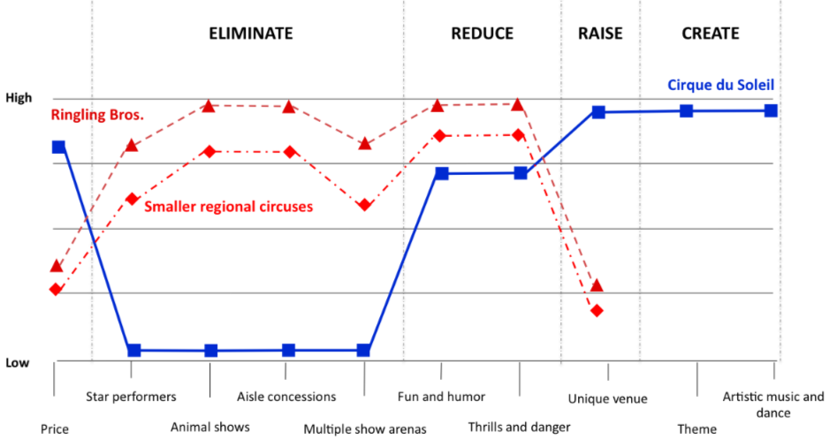
Blue Ocean Innovation & Strategy
Cirque Du Soleil
Perceived Performance
Critical Success Factors
Source: Sage Growth Partners

Slide 74
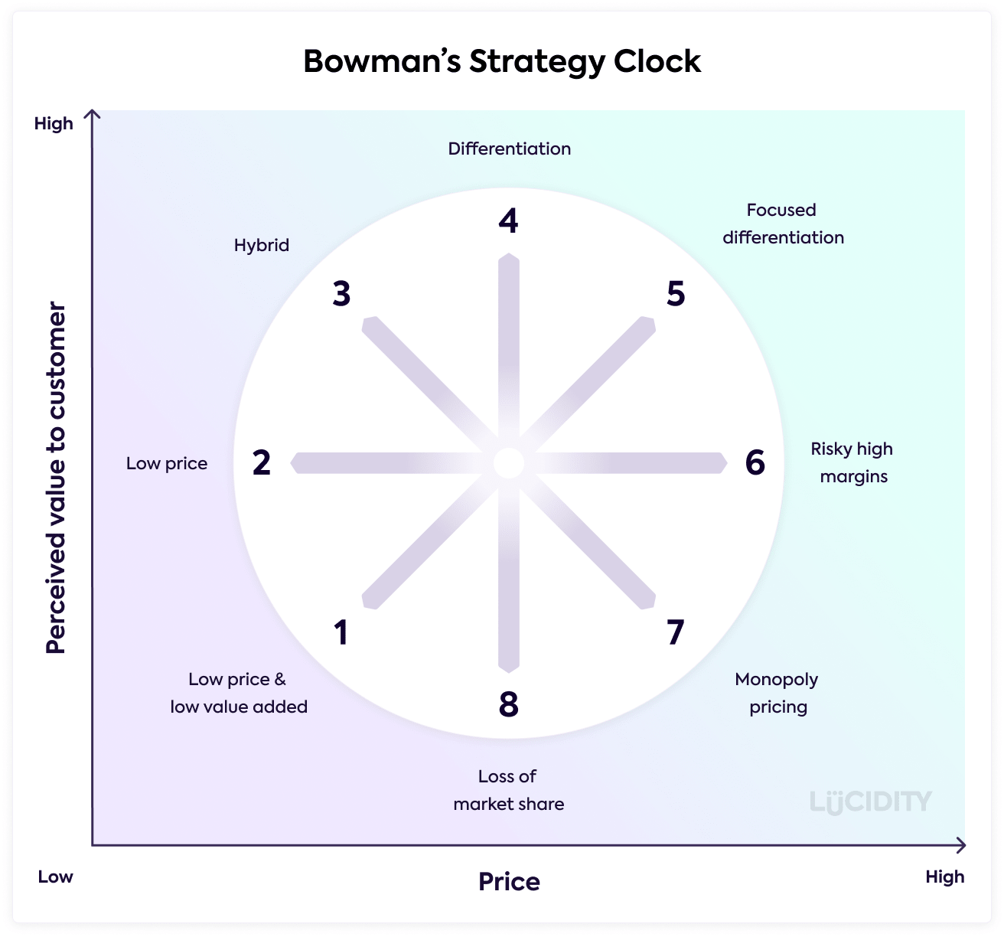
Bowman’s Strategy Clock

Slide 75
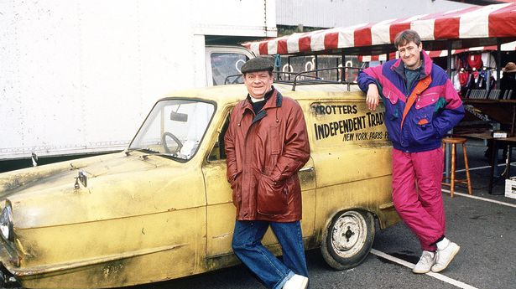
Position 1
Low Price/Low Value
  Companies find themselves at this position, if their products have little differentiated features so they end up selling on price alone
  This is not a position that companies usually choose

Slide 76
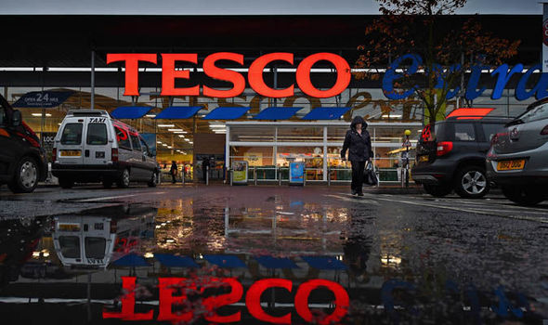
Position 2
Low Price
  Comparable with the low cost leader position of Porter’s generic strategies
  Companies in this position drive prices downwards and look for high volume to counteract low margins
  Over time they look to become the powerful force in the marketplace
  Tesco in the retail sector and Ryanair in the airline sector would be examples of companies taking this position

Slide 77

Position 3
Hybrid
Moderate price/moderate differentiation
An example of a “Best-Cost Provider”
This approach combines a low-cost approach with an emphasis on differentiation with the aim of giving customers more value for their money
Southwest Airlines in the U.S. would be an example of a firm taking this position

Slide 78
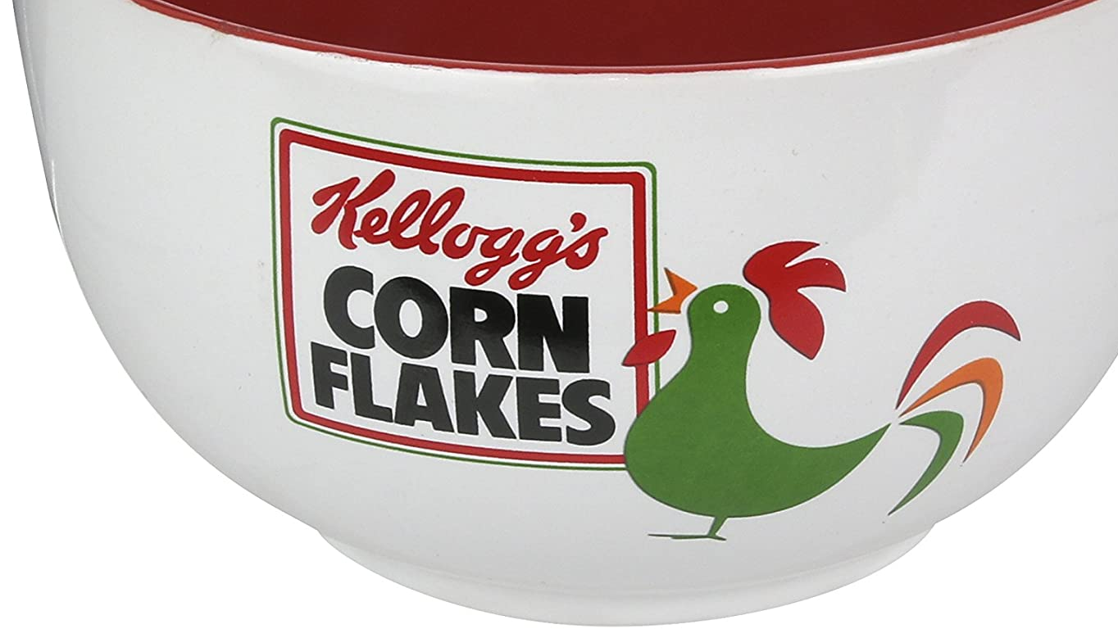
Position 4
Differentiation
Similar to Porter’s view of Differentiation
The aim is to offer customers high perceived-value and either increase their price for higher margins or keep prices lower for increased market share
Branding is an important element with differentiation strategies as the firm wants its name to be synonymous with quality
Nike and Kellogg's are examples of companies taking this position

Slide 79

Position 5
Focused Differentiation
A firm pursuing a focused differentiation strategy aims to offer higher perceived value at a substantial price premium
Consumers buy in this category based on perceived value alone
Gucci, Armani, Rolls Royce are examples of companies pursuing this strategy and they are satisfying the psychological value their customers seek

Slide 80
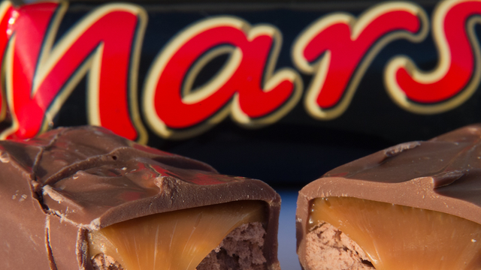
Position 6
Increased Price/Standard Product
A firm increases its price without any increase in quality
If the price increase is accepted the firm will experience increased profits, if it is not accepted their market share declines until they lower the price or add value
This strategy may work in the short term but is doomed to failure in the long run

Slide 81
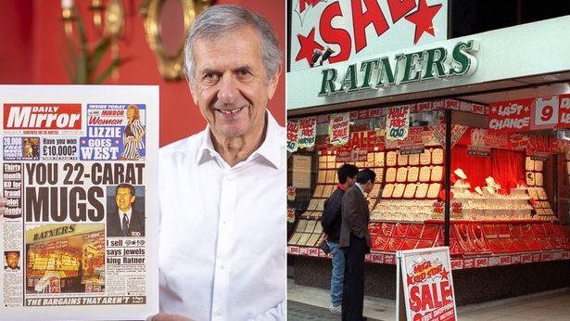
Position 7
High Price/Low Value
A classic monopoly pricing position where companies can charge what they like with no concern about added value where they have no competition
In a market economy monopolies do not tend to last long and companies are forced to compete on a rational basis

Slide 82
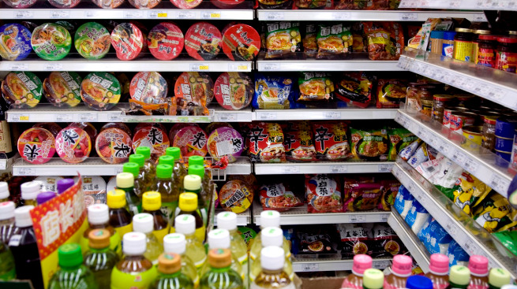
Position 8
Low Value/Standard Price
If a firm has a low value product the price will have to be low to encourage customers to buy it
Any firm that pursues this strategy is bound to fail

Slide 83

Competitive
Market Place
In a truly competitive market place, positions 6, 7, and 8 are bound to fail as the customer will go to companies offering more competitive products or new companies will enter to take business away from companies adopting these positions
Companies using the positioning approach need to understand that it is not static, the relative positions of competitors will change as new entrants come into the market or as companies change their strategies in response to other companies or market conditions
Companies must continually monitor changes in the market

Slide 84
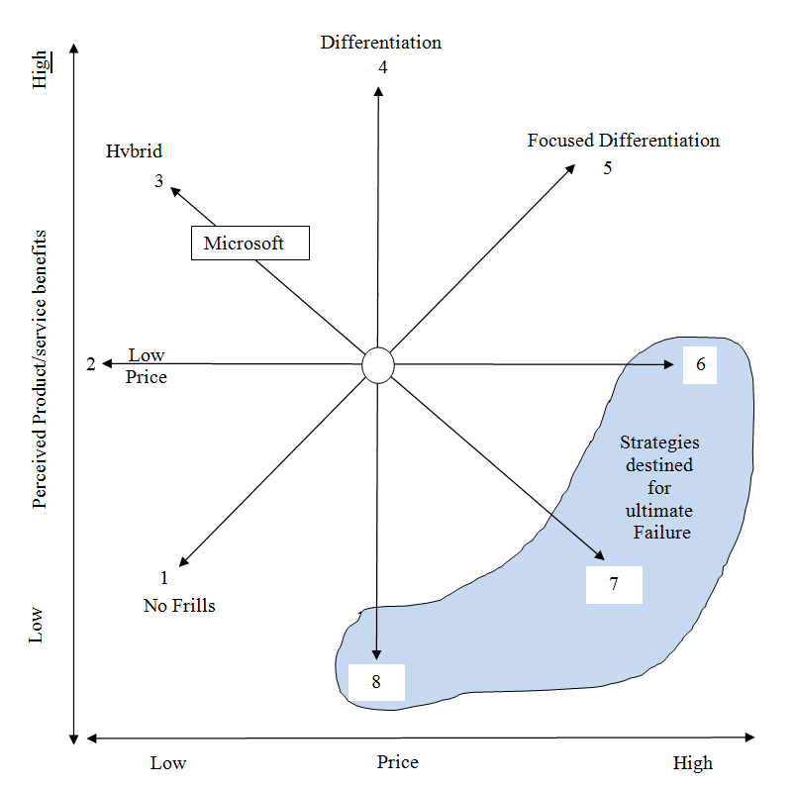
The Strategy Clock
Differentiation and low-cost strategies
https://www.youtube.com/watch?v=enWEwAxhY-Y

Slide 85

Directions of Development
Market Penetration
Market Development
Product Development
Diversification

Slide 86
Corporate Strategy Directions
Products
(A) Protect/Build
Consolidation
Market penetration
(B) Product Development
With existing capabilities
With new capabilities
Beyond current expectations
(C) Market Development
New segments
New territories
New uses
With new capabilities
Beyond current expectations
(D) Diversification
With existing capabilities
With new capabilities
Beyond current expectations
Existing
New
Existing
Existing
Markets
New
New
Adapted from H. I. Ansoff, Corporate Strategy, Penguin, 1988, Chapter 6. Ansoff originally had a matrix with four separate boxes, but in practice strategic directions involve more continuous axes. The Ansoff matrix itself was later developed – see Reference 1 Johnson, Whittington and Scholes, Exploring Strategy, 9th Edition, © Pearson Education Limited 2011

Slide 87

Consolidation & Retrenchment
Consolidation refers to a strategy by which an organisation focuses defensively on their current markets with current products
Retrenchment refers to a strategy of withdrawal from marginal activities in order to concentrate on the most valuable segments and products within their existing business

Slide 88
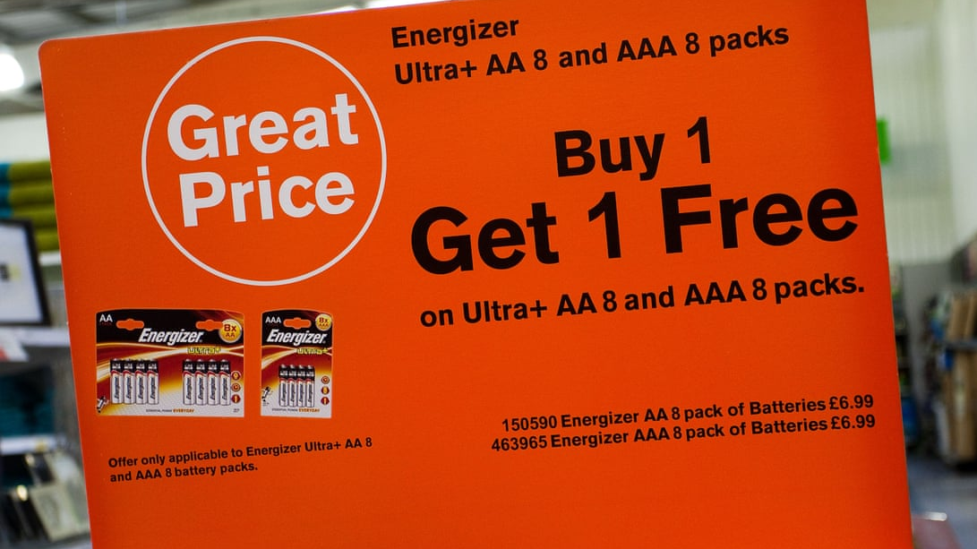
Market Penetration
Firm focuses on selling existing products into existing markets
The aim is to maintain or increase market share of existing products through aggressive sales promotion, more competitive pricing etc.
This is very much about carrying on as usual as the firm focuses on products and markets it already operates in
It is therefore unlikely to require much investment in new market research
Constraints of market penetration
  Retaliation from competitors
  Legal constraints
  Economic Constraints (recession or funding crisis)

Slide 89
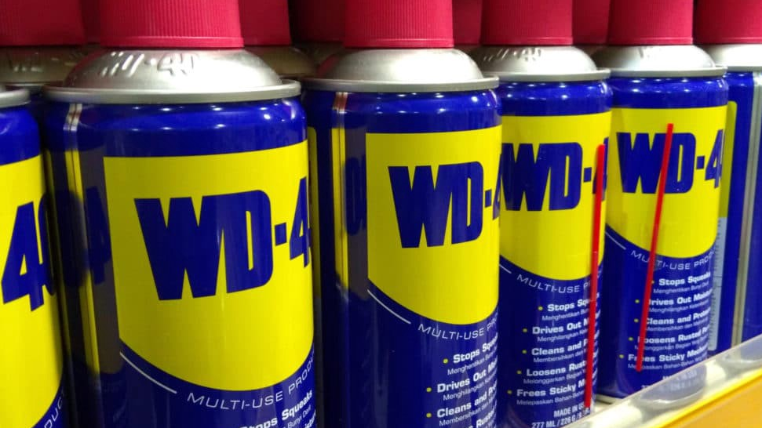
Market Development
Market development - a firm looks to sell its existing products into new markets
This can be new geographical markets, new distribution channels, or new uses for the products
Perhaps one of the best examples of new uses for a product is WD40 (www.wd40.com) where they list over 2000+ uses for this product which have been submitted by customers

Slide 90

Product Development
Product development a growth strategy where a business aims to introduce new products into existing markets
One of the most successful companies for product development is 3M Corporation who among their strategic objectives state an aim that “at least 30% of sales come from products introduced in the past four years”
This strategy is likely to require the development of new competencies and also significant expenditure on research and development

Slide 91

Diversification
Diversification involves increasing the range of products or markets served by an organisation
Related diversification involves diversifying into products or services with relationships to the existing business
Conglomerate (unrelated) diversification involves diversifying into products or services with no relationships to the existing businesses

Slide 92

Diversification
Differs from the other three strategies in that it requires a firm to acquire new skills, new technologies and new facilities
More risky strategy because the firm is moving into markets in which it has little or no experience
For a firm to adopt a diversification strategy, it must have a clear idea about what it expects to gain from the strategy and an honest assessment of the risks
Diversification can be related or unrelated, related means there is an existing connection with value chain

Slide 93
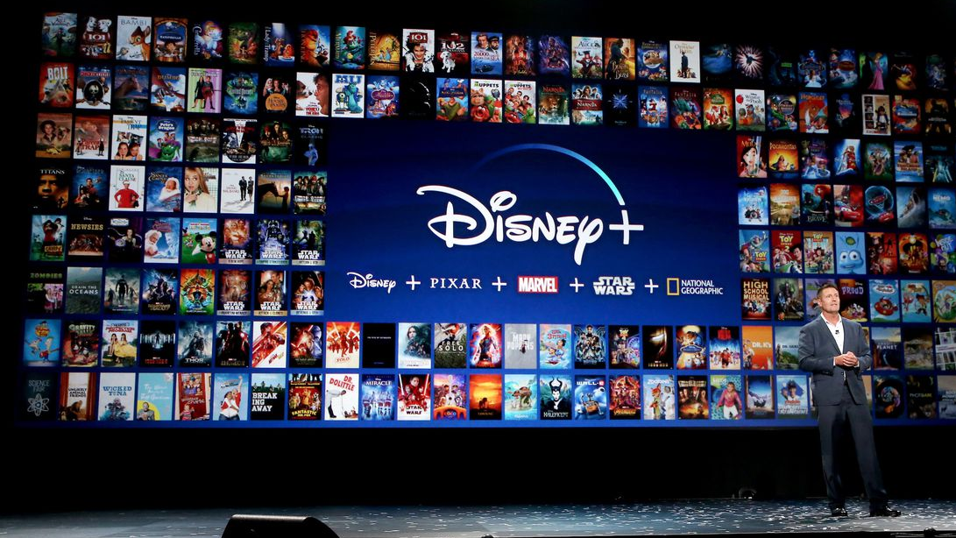
Drivers for Diversification
Exploiting economies of scope
    Efficiency gains through applying the organisation’s existing resources or competences to new markets or services
    Stretching corporate management competences
    Exploiting superior internal processes
    Increasing market power
Some drivers for diversification may involve value destruction (negative synergies)
    Spreading risk and managerial ambition. N.B. Despite these being common justifications for diversifying, finance theory suggests these are misguided
    Responding to market decline

Slide 94
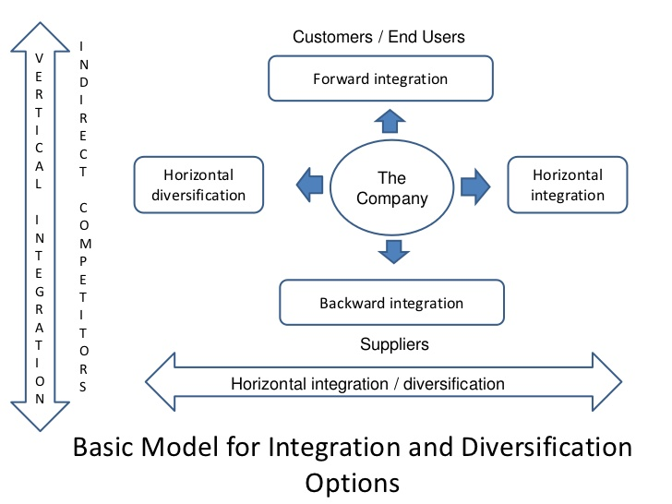
Integration
Car Retail
Vertical integration describes entering activities where the organisation is its own supplier or customer
Backward integration refers to development into activities concerned with the inputs into the company’s current business
Forward integration refers to development into activities concerned with the outputs of a company’s current business
Truck Manufacturer
Bus Manufacturer
Components Manufacturer
Imagine Source: https://www.slideshare.net/rkaysee/chapter-4-corporate-level-strategies

Slide 95

Outsourcing
Outsourcing is the process by which activities previously carried out internally are subcontracted to external suppliers
To outsource or not?
The decision to integrate or subcontract rests on the balance between two distinct factors:
  Relative strategic capabilities: Does the subcontractor have the potential to do the work significantly better?
  Risk of opportunism: Is the subcontractor likely to take advantage of the relationship over time?

Slide 96

Value-adding & Destroying Activities
Value-adding Activities
    Envisioning
    Coaching and facilitating
    Providing central services
    Resources Intervening
Value-destroying Activities
    Adding management costs
    Adding bureaucratic complexity
    Obscuring financial performance

Slide 97
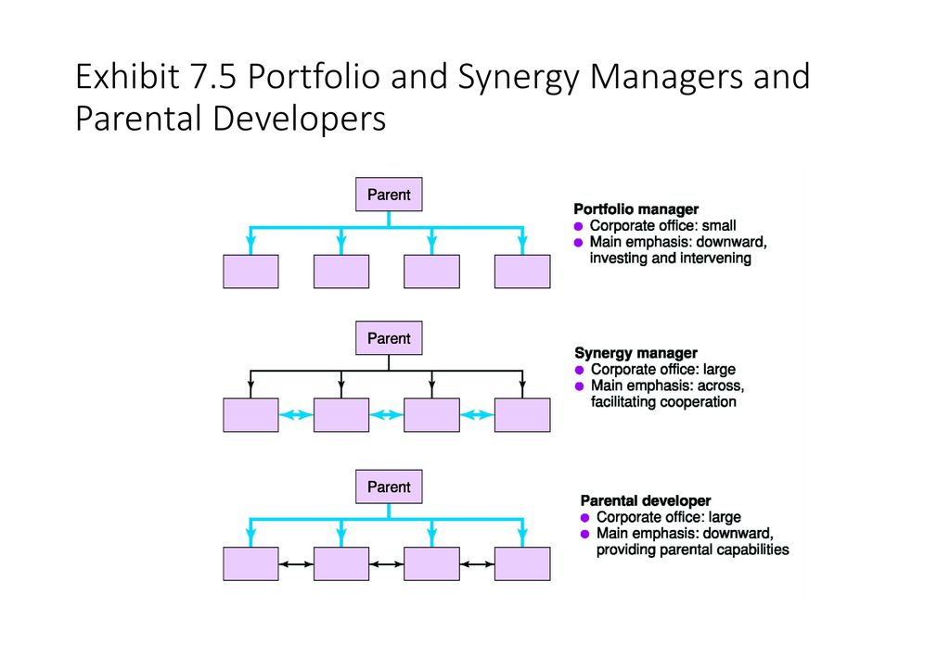
Corporate Rationales
The portfolio manager operates as an active investor in a way that shareholders in the stock market are either too dispersed or too inexpert to be able to do.
The synergy manager is a corporate parent seeking to enhance value for business units by managing synergies across business units
The parental developer seeks to employ its own central capabilities to add value to its businesses
Corporate rationales (1) Figure 7. 5 Portfolio managers, synergy managers and parental developers Source: Adapted from M. Goold, A. Campbell and M. Alexander, Corporate Level Strategy, Wiley, 1994 Johnson, Whittington and Scholes, Exploring Strategy, 9th Edition, © Pearson Education Limited 2011

Slide 98

Porter’s Five Forces (1980)
Threat of entry of new firms
  Economies of scale, capital requirement, access to distribution channels, absolute cost advantages, expected retaliation, government policy, differentiation, switching costs for buyers
Power of buyers
  Concentration of buyers, alternative sources of supply, component cost as a percentage of total cost, possibility of backward integration
Power of suppliers
  Number of suppliers, switching costs, brand power, possibility of forward integration, dependence of customer
Power of substitutes
  Relative price & performance, switching costs, buyer’s willingness to substitute
Intensity of rivalry among existing firms
  Industry growth, high fixed costs, volatile demand, product differentiation, extra capacity in large increments, balance of firms, high exit barriers

Slide 99
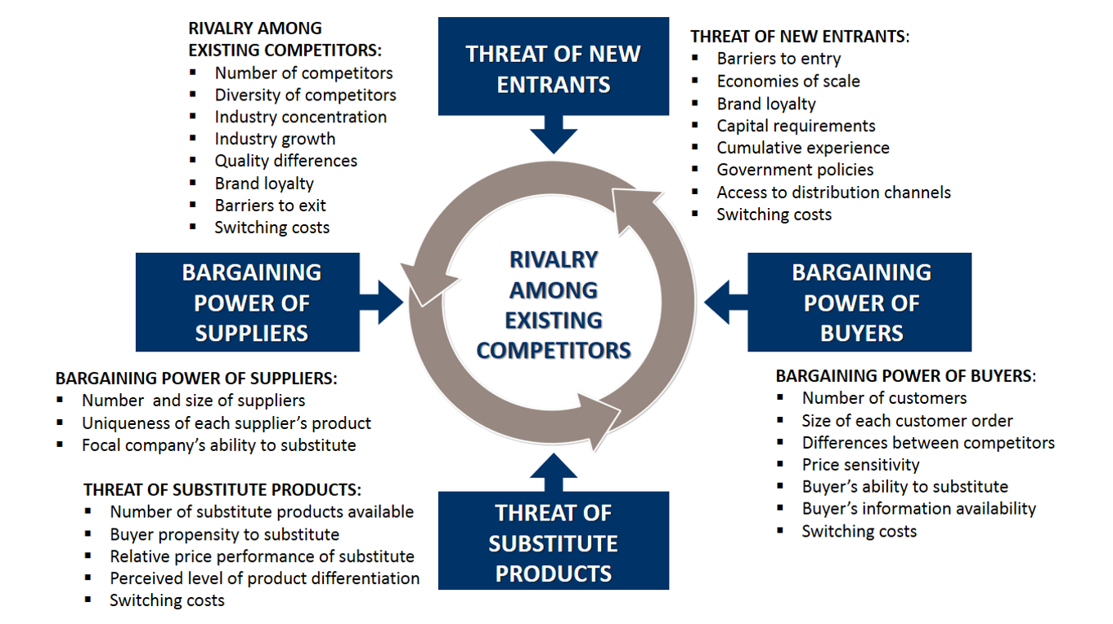
The Five Forces (Porter, 1985)

Slide 100
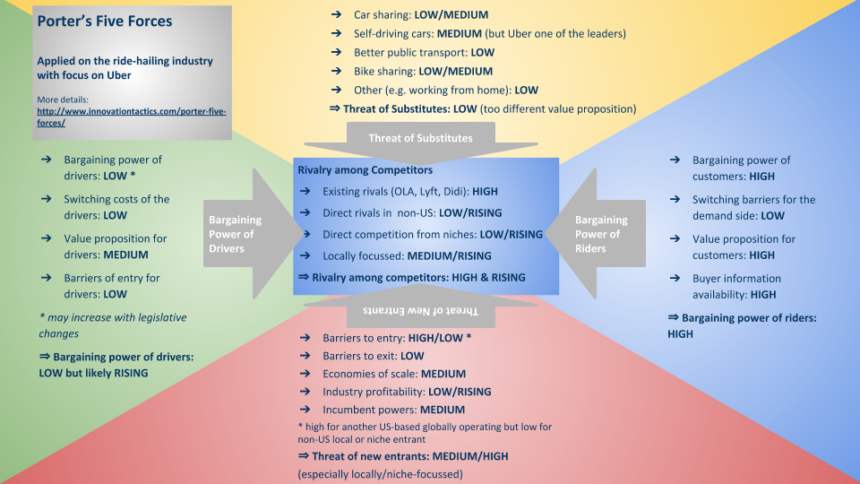

Slide 101

Five Forces Criticism
Product of its time, economy has changed since globalisation
Larry Downes (1997) three forces – Digitisation, Globalisation, Deregulation
Note the convergence of industries – particularly in the high-tech sectors (e. g. digital industries mobile phones/cameras/MP33 players).
Sarah Coles (2009) - Does not consider the role of Government, CSR, company culture, only provides a snapshot, a tick box
Dalken (2014) - internet revolutionised access to information – buyers & sellers
May discourage innovation efficiency at the cost of effectiveness
Assume competition is zero-sum game – co-operative strategies such as joint ventures
Note the importance of complementary products and services (e. g. Microsoft windows and Mc. Afee computer security systems are complements). This can almost be considered as a sixth force.
Issues in five forces analysis - apply at the most appropriate level – not necessarily the whole industry. E.g., the European low-cost airline industry rather than airlines globally
Counter arguments (Porter, 2008) ‘In essence the job of a strategist is to understand and cope with competition’

Slide 102
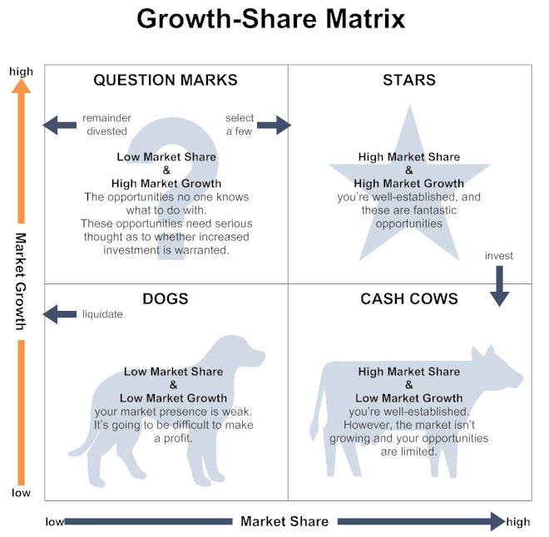
Boston Matrix

Slide 103
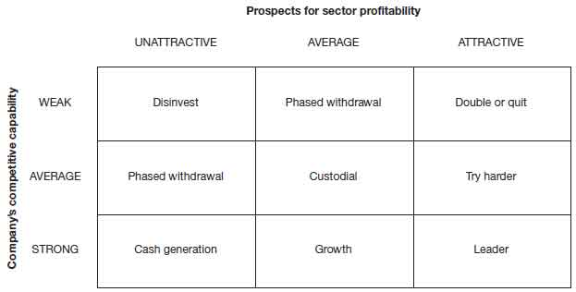
Shell Directional Policy Matrix
Meets some of the criticisms of the Boston Matrix
Rather than using market share as a variable, use enterprises capabilities, assessed as weak, average, strong
Other factors considered such as managerial skill, technology etc.
Uses a 3x3 grid as opposed to the 2x2

Slide 104
Potential Benefits & Dangers of Strategic Planning
Benefits | Dangers
Helping determine and direct strategy | Confusing strategy with the strategic plan
Help understand strategic issues | Detachment from reality
Coordinating business-level strategies | Paralysis by analysis
A means of implementing an agreed strategy | Lack of creativity
Involving people and creating ownership of a strategy | Damping of innovation

Slide 105
SAFe Criteria
Proposed strategies may be evaluated using the three SAFe criteria
Suitability is concerned with assessing which proposed strategies address the key opportunities and constraints an organisation faces. It is about the rationale of a strategy
Acceptability of a strategy relates to three issues: the level of risk of a strategy, the expected return from a strategy and the likely reaction of stakeholders
Feasibility is concerned with whether an organisation has or can obtain the capabilities to deliver a strategy

Slide 106

Management Challenges
In managing strategy development processes, managers face challenges including:
      Multiple processes of strategy development are likely to be needed if organisations are to achieve both the benefits of the exploitation of existing capabilities and the exploration for new ideas & capabilities (organisational ambidexterity)
      Recognising that different processes of strategy development may be needed at different times and in different contexts
      Managing the processes that give rise to emergent strategy

Slide 107

Evaluation Criteria
Four qualifications:
Conflicting conclusions and the need for management judgement
Consistency between the different elements of a strategy is essential
The implementation and development of strategies might reveal unanticipated problems
Strategy development in practice – it isn’t always a logical or even rational process

Slide 108
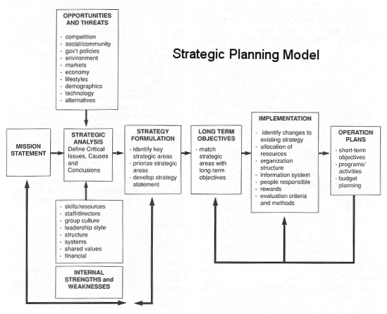
Strategic Commitment

Slide 109

Summary
Industries and sectors are dynamic, and their changes can be analysed in terms of the industry life cycle, comparative five forces and cycles of competition
In the inner layer of the environment, strategic group analysis, market segment analysis and the strategy canvas can help identify strategic gaps or opportunities
Blue Ocean strategies characterised by low rivalry are likely to be better opportunities than Red Ocean strategies with many rivals
The most important reason for environmental analysis is to identify OPPORTUNITIES & THREATS

Slide 110

Apply the Analysis Tools
PESTEL – your own organisation
TOWS – your own organisation
Boston Matrix – your organisation
Five Forces - your own organisation

Slide 111

References
Kew, J. and Stredwick, J. (2016) Human Resource Management in a business context. 3rd ed. London: Chartered Institute of Personnel and Development.
Book Johnson, Whittington and Scholes, (2009) Exploring Strategy, 9th Edition, Pearson Education Limited 2009
Johnson, Whittington and Scholes, (2011) Exploring Strategy, 11th Edition, Pearson Education Limited

